Slide 1
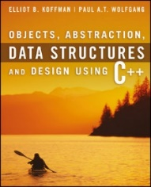
Welcome to
CS 235 Data Structures
Introduction (01)

Slide 2
Tip #01: Keys to Success
What should you do If you find yourself (and we all do):
struggling with the material,
falling behind on assignments,
facing personal problems,
lacking motivation, or
experiencing any difficulty that effects your schoolwork…
Some suggestions:
Talk with the professor at the first sign of problems.
Resolving problems sooner is always better than later.
Attend all in-person sessions,
Do the reading and watch videos BEFORE class,
Work with the TAs as needed – especially in off-peak hours,
Run to completion – avoid context switching (distractions).
Get started early on labs...
Little (if any) can be done to improve your grade if you wait until reading day.

Slide 3
CS 235
Syllabus

Slide 4
Learning Outcomes
CS 235 is an introductory course in data structures and algorithms.
Data Computing Fundamentals - Learn the strengths and weaknesses of a variety of data structures, so you can choose the best data structure for your data and applications (lists, stacks, queues, priority queues, sets, maps, trees, etc.).
Analysis - Apply basic algorithm analysis.
Recursion - Understand how recursion works and write programs using recursion to solve problems.
Sorting and Searching Algorithms - Learn many of the algorithms commonly used to sort data, so your applications will perform efficiently when sorting large datasets.
Program Writing - Implement of each data structure, so you understand how they work under the hood (using an IDE).

Slide 5
CS 235 Prerequisites
Students must have completed CS 111 or 142 (or an equivalent) with a passing grade before taking CS 235.
We make the following assumptions in CS 235:
You have previously taken and passed an introductory programming course.
You have some experience with a general purchase, middle-level programming language (ie. Python, Java, C, C++).
You have some understanding of the basic principles of object-oriented programming (classes, objects, methods, inheritance, polymorphism, etc.).
You know what an IDE is and how to use breakpoints and single-step code (used extensively in this course).
You should understand basic debugging techniques.
If you have not satisfied all of the above prerequisites, you maybe should consider taking more prepartory classes before attempting CS 235.

Slide 6
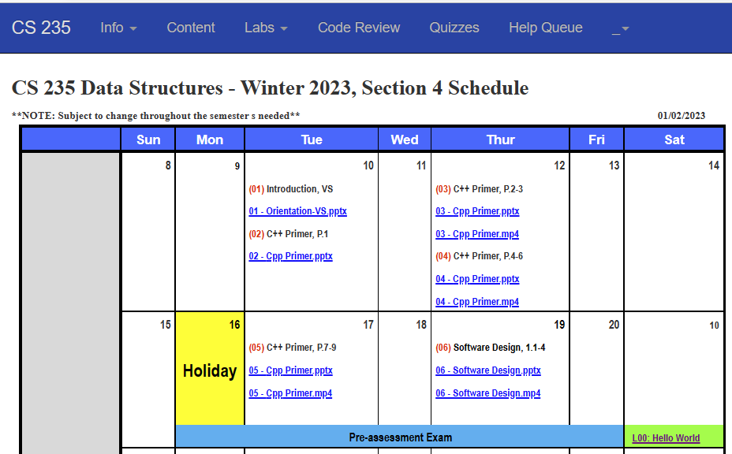
students.cs.byu/~cs235ta

Slide 7
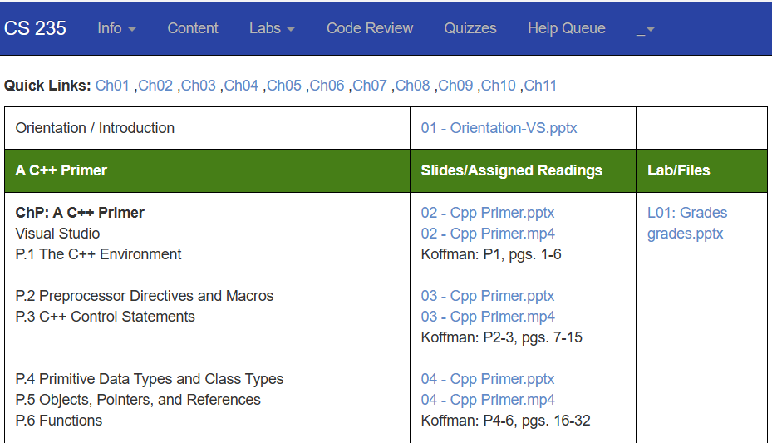
students.cs.byu/~cs235ta

Slide 8
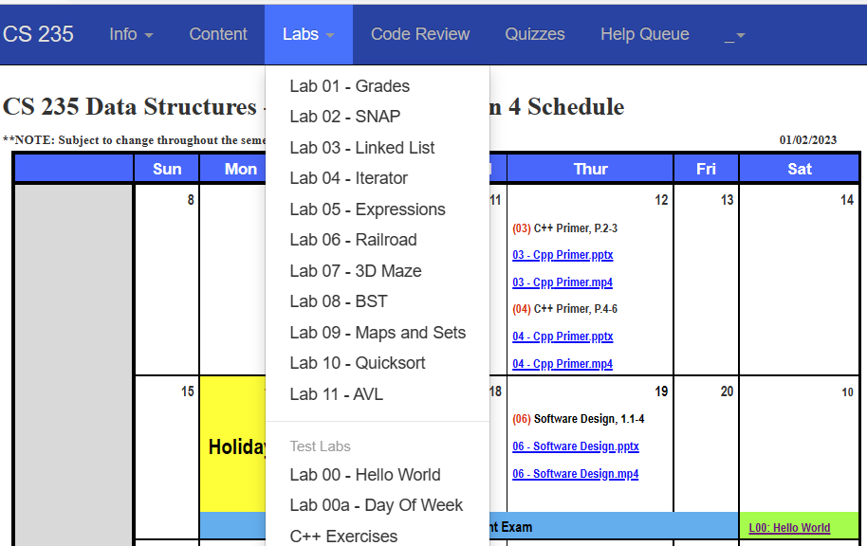
students.cs.byu/~cs235ta

Slide 9
students.cs.byu/~cs235ta

Slide 10
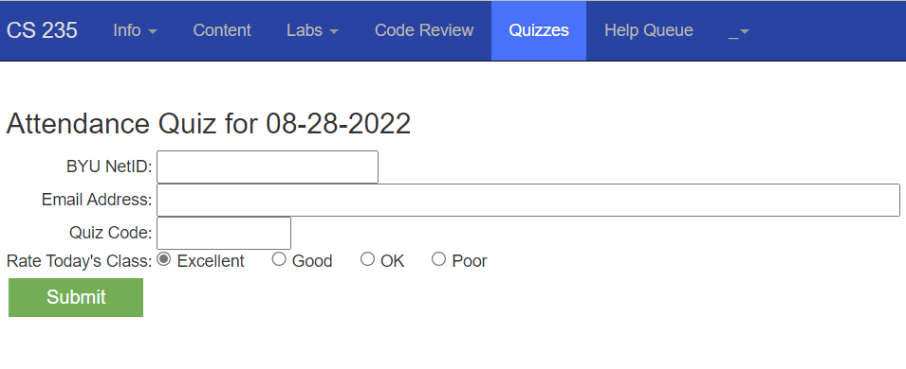
students.cs.byu/~cs235ta

Slide 11
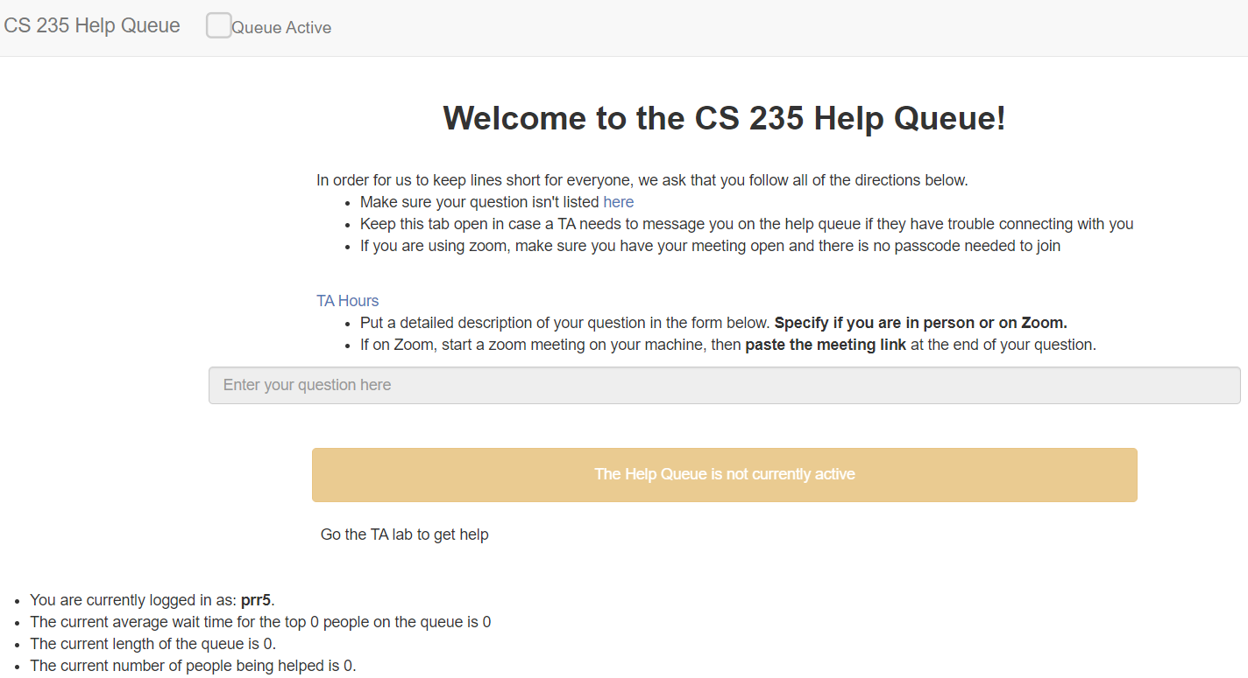
students.cs.byu/~cs235ta

Slide 12
Course Assessment
Programming Assignments. (Performance-based assessment) 40%
Hands-on application of section concepts.
Improve programming skills.
Solve practical problems.
Develop critical/analytical thinking.
Peer Evaluations / Quizzes. (Formal assessment) 20% + 5%
Target areas needing work.
Help preparation for exams.
Provide immediate feedback.
Gage progress with your peers.
Motivate study.
Identify strengths/weaknesses.
Mid-term/Final Exams. (Summative assessment) 40%
Compare student knowledge against standard.
Guide efforts and activities in subsequent courses.
Fulfill accreditation requirements.

Slide 13
Grading Policy
Weighted contributions to your final grade:
Programming Labs: 60%
Auto-graded: 40%
Peer Review: 10%
Review Assignments: 10%
Exams: 40%
Pre-exam: 2%
2 Midterms: 20%
Final Exam: 18%
Attendance Quizzes: 5% (extra credit)
Need 10 labs for full lab credit (11th lab of your choice is bonus).
All exams will be administered through Learning Suite.
Attendance quizzes available on class website.
The quiz code is given during class time.
Quiz codes expire at the end of the following day.
A = 93% C = 73%
A- = 90% C- = 70%
B+ = 87% D+ = 67%
B = 83% D = 63%
B- = 80% D- = 60%
C+ = 77% E = below 60%

Slide 14
Programming Assignments (60%)
Auto-graded lab submission.
Zip together all your lab source files (.cpp, .hpp, .h) – no folders or IDE files.
Submit your zipped lab source folder using the “Labs” tab on the class website.
The auto-grader will immediately:
Unzip and compile your submitted source using the Linux g++ compiler.
If there are no compilation errors, the resulting executable will be run using command line arguments to select both input and output files.
Your program results will be graded and the results reported immediately on the submission web page.
Points will be deducted for any detected memory leaks, warnings, and/or out-of-bounds array references.
Random, anonymous peer reviews start immediately after due date.
Only on-time, zipped solutions (earning more than 10 points) are accepted for peer review.
Results returned via email and recorded in BYU grades.
Use a unique coding pseudo-name (e.g. Cody Coder III, Franky Forloop, Doesy Dowhile) on source headers.

Slide 15
Help...
TA help via Zoom using Help Queue tab
Include your personal Zoom ID (that does NOT require a password.)
Include ONE specific question.
TA's have been instructed to answer ONE detailed question (maximum of 10 mins when there are other students in the queue.)
After consulting with a TA and then privately working on the problem, you may rejoin the help queue.
Do not make TA help a welfare system - TA's are to clarify lab assignments, add a "second set of eyes" to student programming assignments, and motivate students in creative directions.
TA's are NOT responsible for debugging student programs or providing lab solutions.
Professor help via Zoom
Email me (proper@cs.byu.edu) to setup a private meeting using your personal Zoom ID.

Slide 16
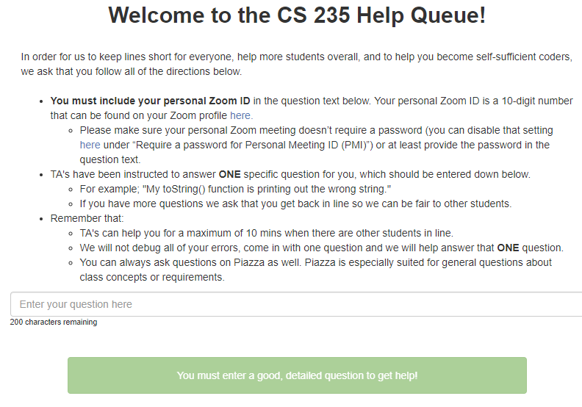
Help Queue

Slide 17
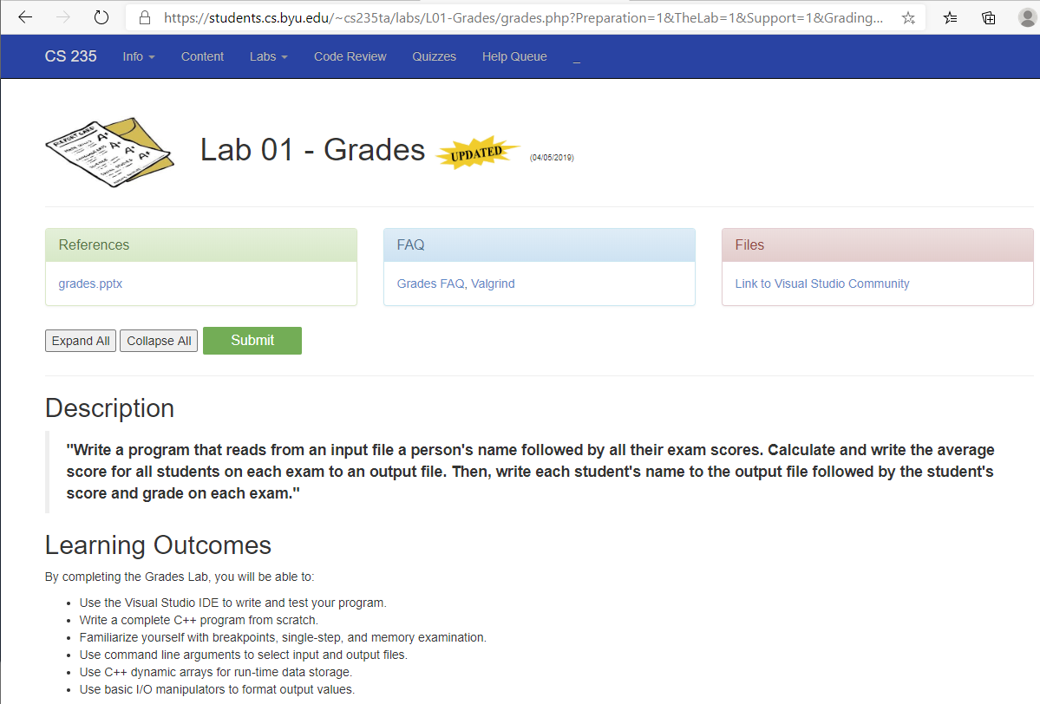
Class Preparation
Read textbook assignment.
Watch video lecture.
Study lab requirements.
4. Start working on lab.
5. Ask any questions (via email).
Class Participation
5. Attend in-person class for:
• Answer email/chat questions
• Review of readings
• Discussions of lab requirements
• Program lab examples
6. Take attendance quiz as soon as possible.
Class Follow-thru
7. Complete lab.
• TA help
• Study buddy
• Virtual office hours
8. Do peer reviews.

Slide 18
Miscellaneous
Late Lab submissions
50% penalty on late portions of a lab.
Missed peer review points can not be recovered.
DO NOT post your work on a public repository (e.g. github, Learning Suite, Bitbucket, etc)!
We troll often – results in failing the course.
Private repositories are encouraged.
Do your own work.
Sharing of code is cheating! (Sources compared with current and past submissions.)
Working/studying with peers is encouraged!
Check your email often.
Do not use LS email to communicate with me. (Use proper@cs.byu.edu.)
Please sit close to another student during class!!!

Slide 19
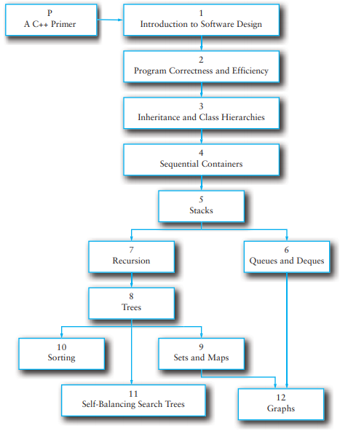
CS 235 Overview
C++ Primer | 6
Part 1: Abstract Data Types
Ch01: Introduction to Software Design Ch02: Program Correctness and Efficiency Ch03: Inheritance and Class Hierarchies | 6 | L1: Grades L2: SNAP
Part 2: Containers
Ch04: Sequential Containers Ch05: Stacks Ch06: Queues and Deques | 6 | L3: Linked List L4: Iterator L5: Shunting Yard L6: Railroad
Part 3: Recursion
Ch07: Recursion | 6 | L7: 3dMaze
Part 4: Trees, Maps, Sets
Ch08: Trees Ch09: Sets and Maps | 6 | L8: BST L9: Maps and Sets
Part 5: Sorting, Search
Ch10: Sorting | 6 | L10: Quicksort
Part 6: AVL Trees and Graphs
Ch11: Self-Balancing Search Trees Ch12: Graphs | 6 | L11: AVL

Slide 20
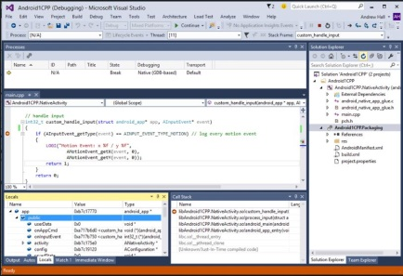
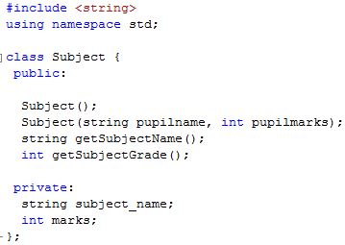
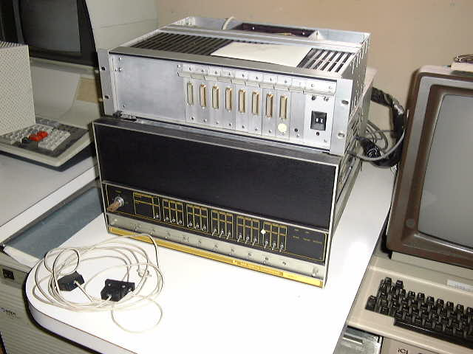
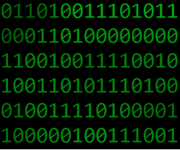
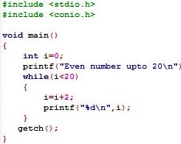
Why Use An IDE?
“Real men (and women) use plain text editors to write code in assembly.”
Machine
Code
Assembly
C
C++
Java
Python
Symbolic
Debugger
Industry needs skilled developers who know how to:
Use breakpoints
Single step
Inspect / change process memory
Symbolic debuggers highlight scope, keywords, vertical whitespace, outline modules, performance, variable watch, among others.

Slide 21
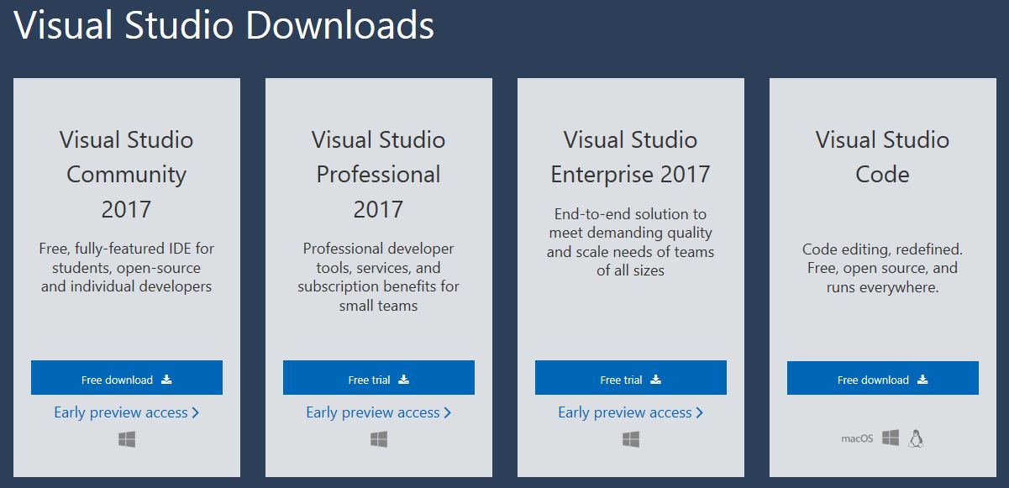
Visual Studio Community
Step 1: Go to website http://www.visualstudio.com/en-us/downloads/download-visual-studio-vs#DownloadFamilies_2
Step 2: Find the panel titled Visual Studio Community 20xx for Windows Desktop and click on .

Slide 22
Xcode for Macs
C++ is a standard not an application.
Your source code should compile and execute independent of what compiler or IDE you choose (VS, Xcode, gcc, g++).
Visual Studio uses Microsoft C++ Compiler (MSVC).
Xcode uses Clang C/C++/Objective-C compiler frontend with LLVM as backend.
Linux, MinGW, Cygwin use GNU gcc compiler.
gcc will compile: *.c/*.cpp files as C and C++ respectively.
g++ will compile: *.c/*.cpp files but they will all be treated as C++ files.
g++ automatically links in the std C++ libraries (gcc does not.)
The auto-grader uses the g++ compiler for auto-grading.
Always include the VS crt macros in your main source file.
https://developer.apple.com/library/content/documentation/DeveloperTools/Conceptual/InstrumentsUserGuide/FindingLeakedMemory.html
Thing to avoid:
Special library calls (e.g. getenv("MYARQ"))
https://www.youtube.com/watch?v=FzuDUnoNQo0
https://jtdaugh.github.io/xcode-umich/

Slide 23
You Decide...
From: Daniel Woolwine <daniel.woolwine@gmail.com> Sent: Thursday, March 5, 2020 1:55 PM To: Paul Roper <proper@cs.byu.edu> Subject: Follow Up
Professor Roper,
We met Monday to discuss tips for doing better in the class. I just wanted to follow by saying I completed the second half of Railroad in less than half the time when applying your suggestions, and even did the extra credit. Thank you so much!
Thanks again for everything.
Daniel Woolwine
CS235
Industry needs skilled developers who know how to:
Use breakpoints
Single step
Inspect / change process memory
Symbolic debuggers highlight scope, keywords, whitespace, outline modules, performance, variable watch, among others.

Slide 24
Memory Leaks

Slide 25
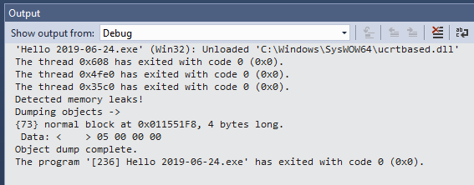
Memory Leaks
Memory leak - failure to correctly deallocate memory that was previously allocated.
Particularly serious issue for programs like daemons and servers which never terminate.
Security breeches exploit memory leaks..
Among the most subtle and hard-to-detect bugs.
All labs are required to be free from memory leaks.
#define _CRTDBG_MAP_ALLOC
#include <stdlib.h>
#include <crtdbg.h>
#define VS_MEM_CHECK _CrtSetDbgFlag \
(_CRTDBG_ALLOC_MEM_DF | _CRTDBG_LEAK_CHECK_DF);
int main()
{
VS_MEM_CHECK // check for memory leaks
int *var = new int(5);
return 0;
}
Basically, a memory leak occurs when you call new without calling a corresponding delete later.
int main()
{
int *p = new int;
delete p; // no leak
int *q = new int;
// no delete results in memory leak
}

Slide 26
Be Safe

